Slide 1
Material classification method for electrostatic effect
Author: xiao237@purdue.edu

Slide 2
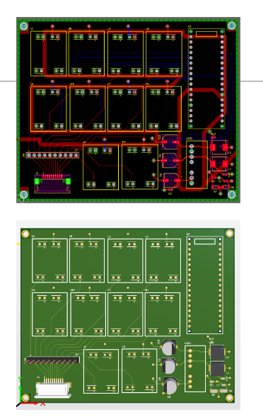
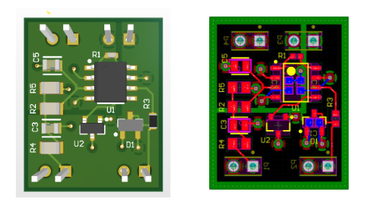
Analog Frontend (type I)

Slide 3
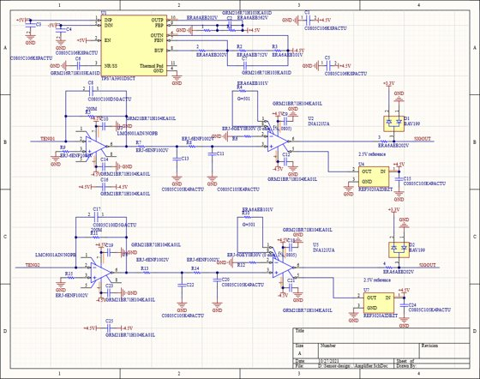
Analog Frontend (type II)

Slide 4
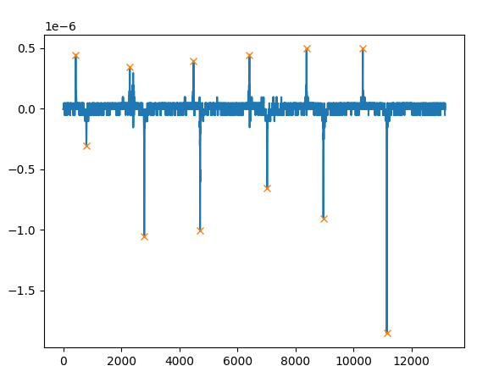
Segmentation (peak finding)

Slide 5
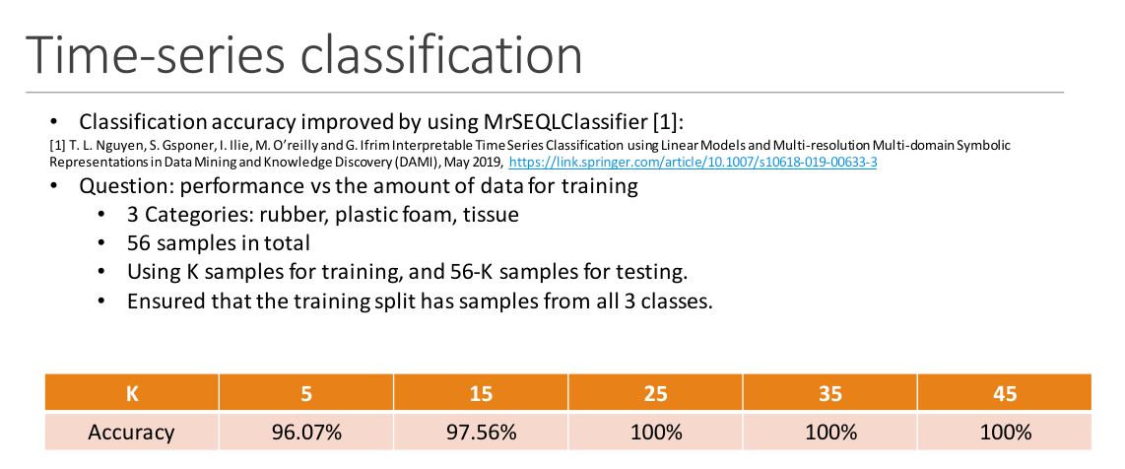
Classification

Slide 6
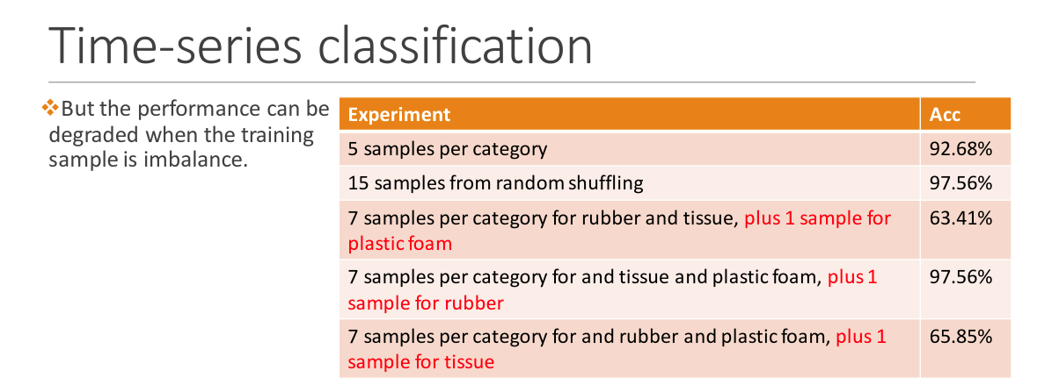
Classification

Slide 7
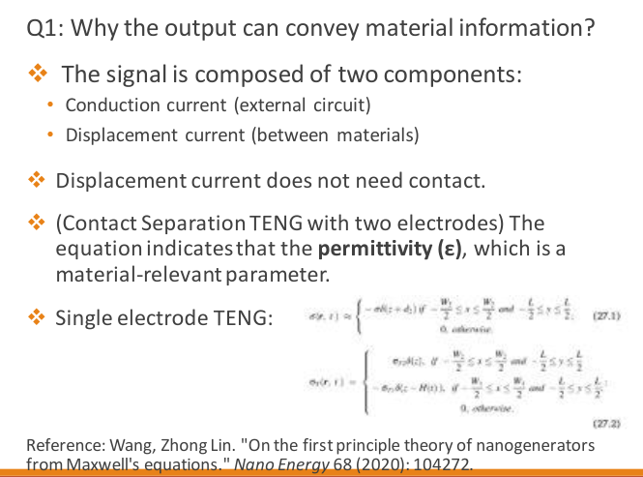
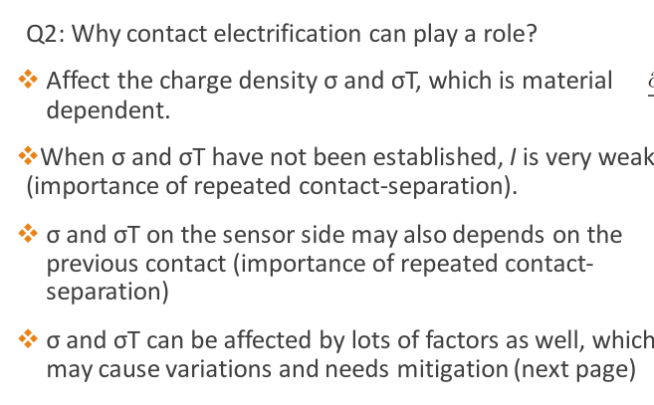
Principle

Slide 8
Contributions
1. Design of frontends.
2. The first to model material classification as a time-series classification
3. segmentation techniques

